Slide 1



DACdb (“District and Clubs Data Base”)
The D5500 Membership Management System Switch Your Club to DACdb Direct Connect
Leo Lawrenson , Leo@Lawrenson.com

Slide 2
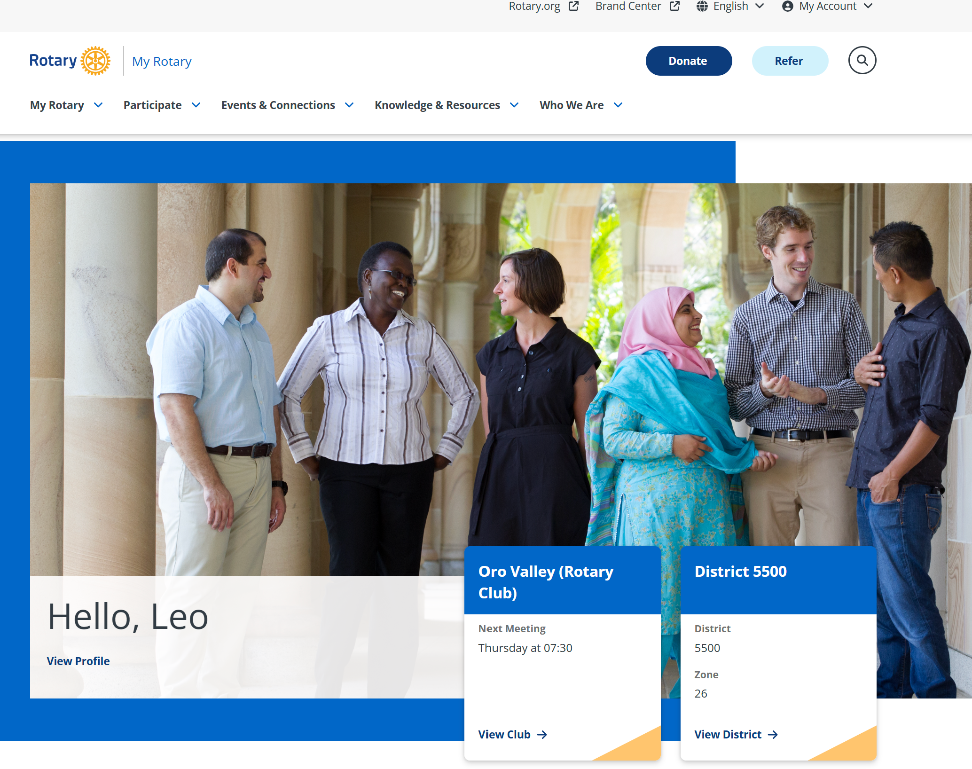
DACdb-RI Connection
After Logging into MyRotary

Slide 3
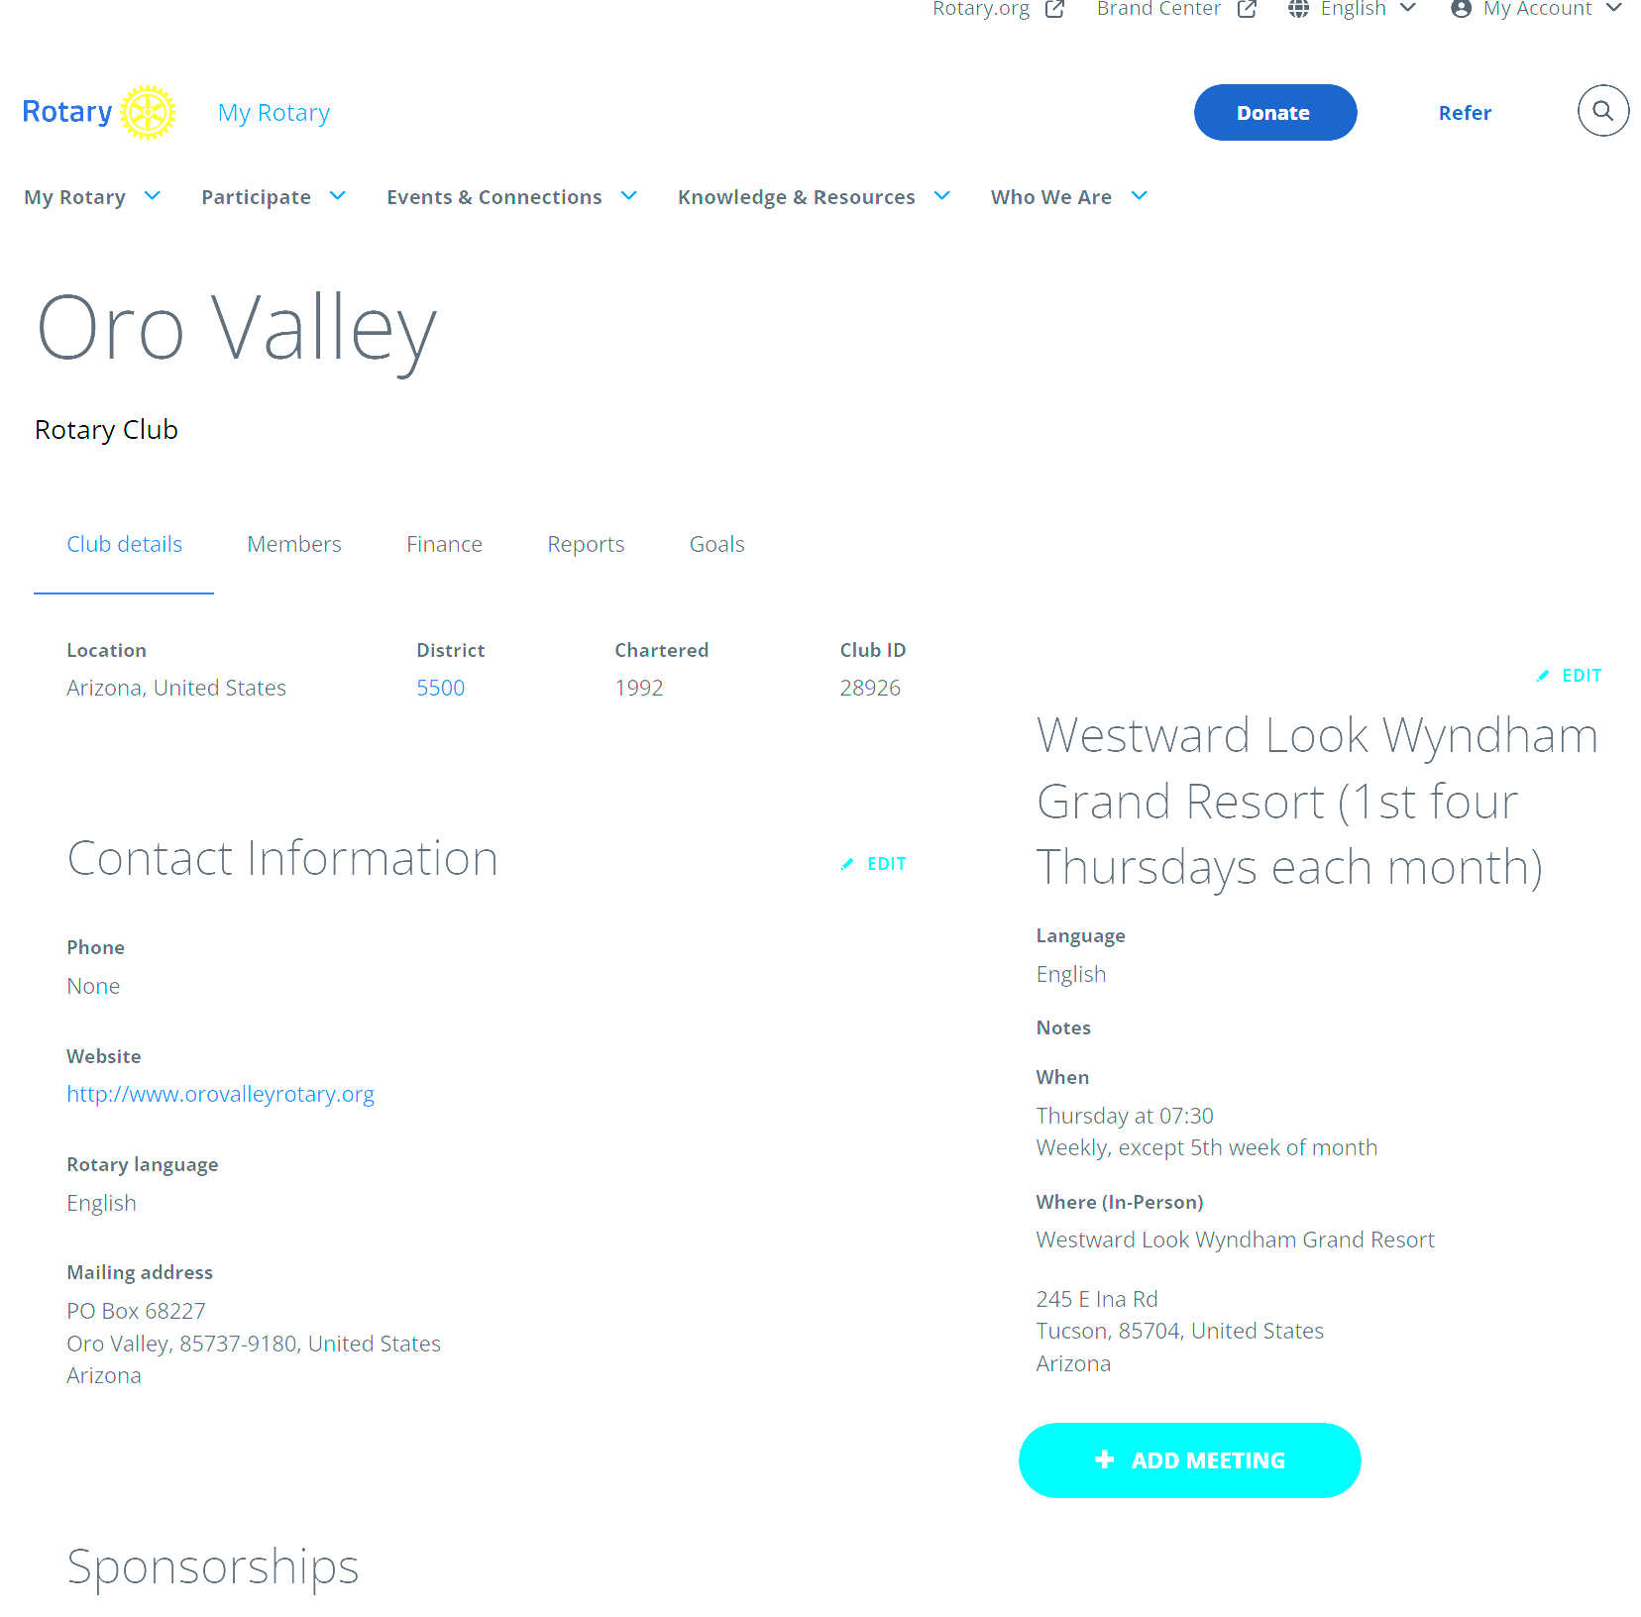
DACdb-RI Connection on
MyRotary.org
Scroll Down

Slide 4
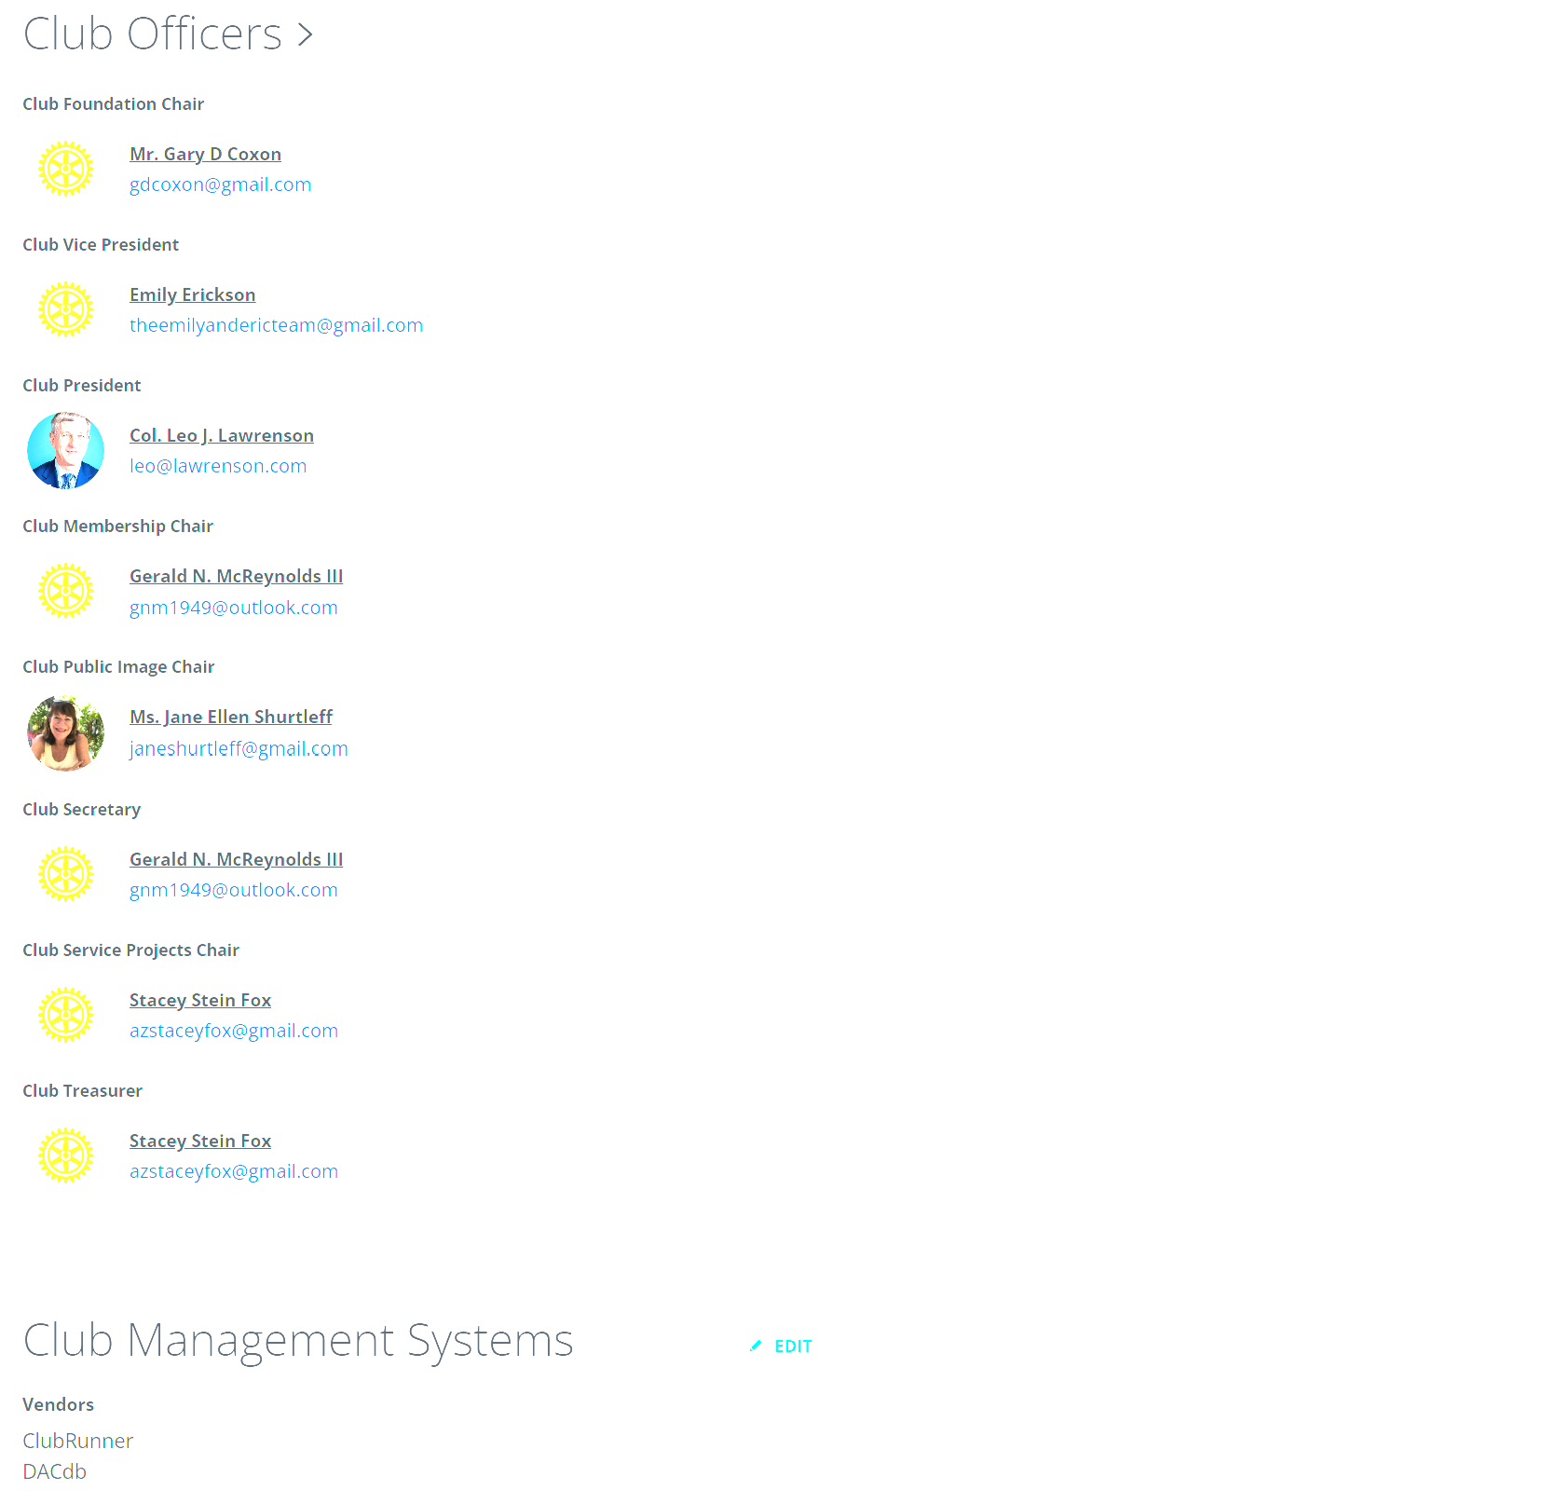
DACdb-RI Connection on
MyRotary.org
Click “Edit”

Slide 5
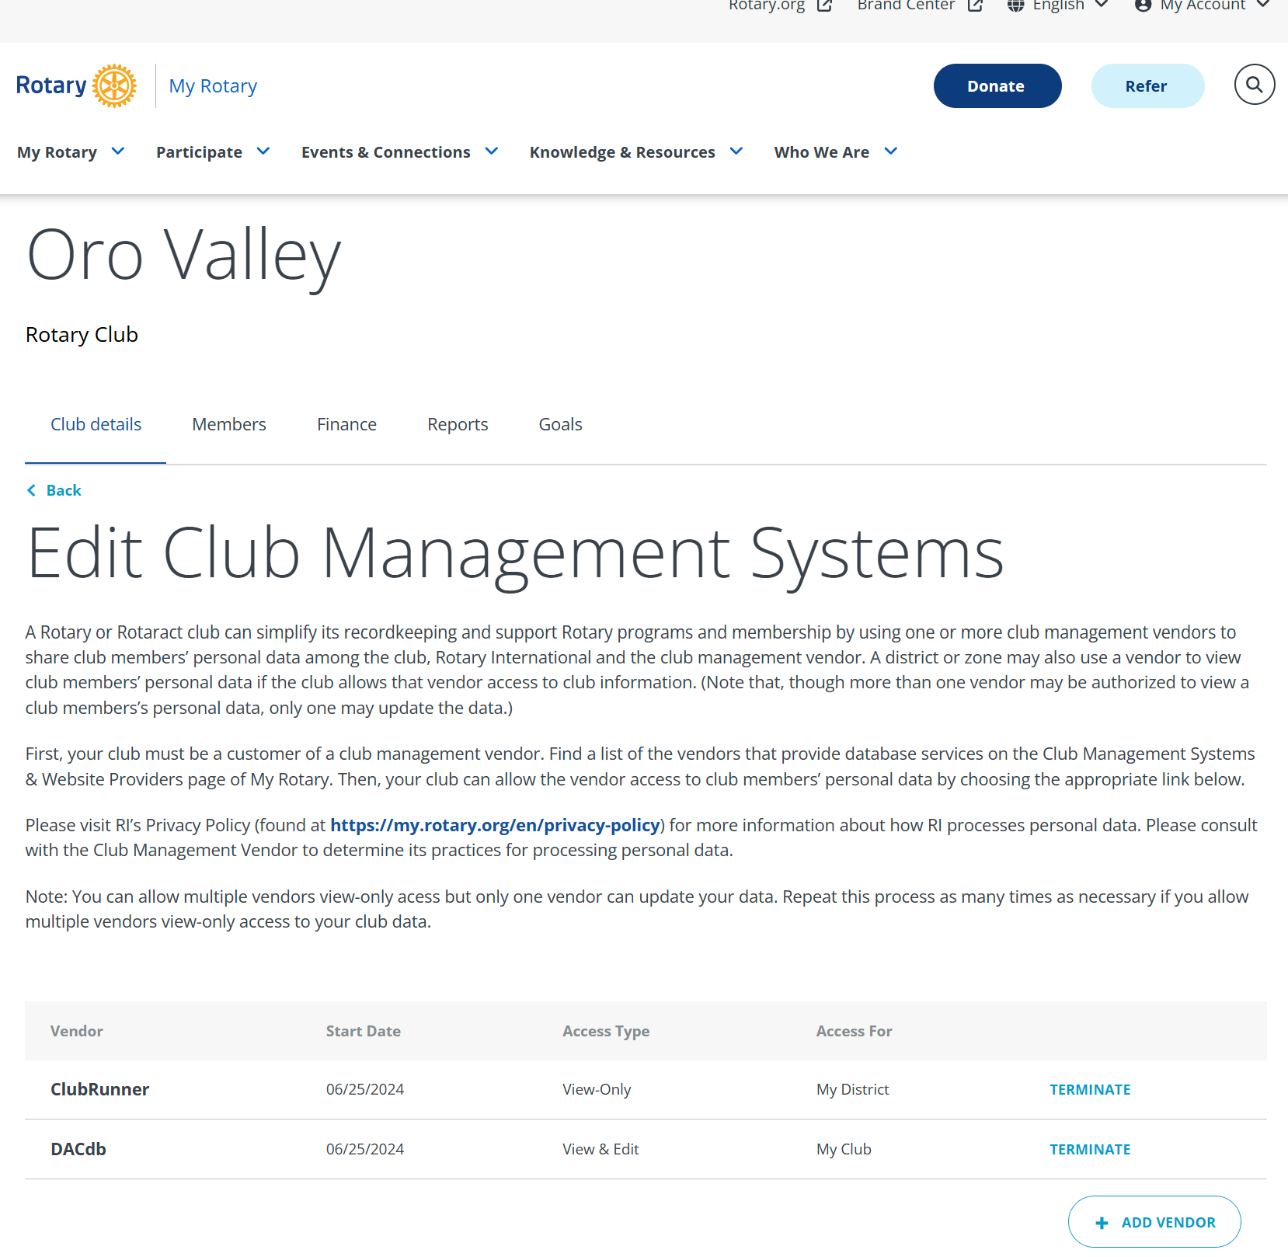
DACdb-RI Connection on
MyRotary.org

Slide 6
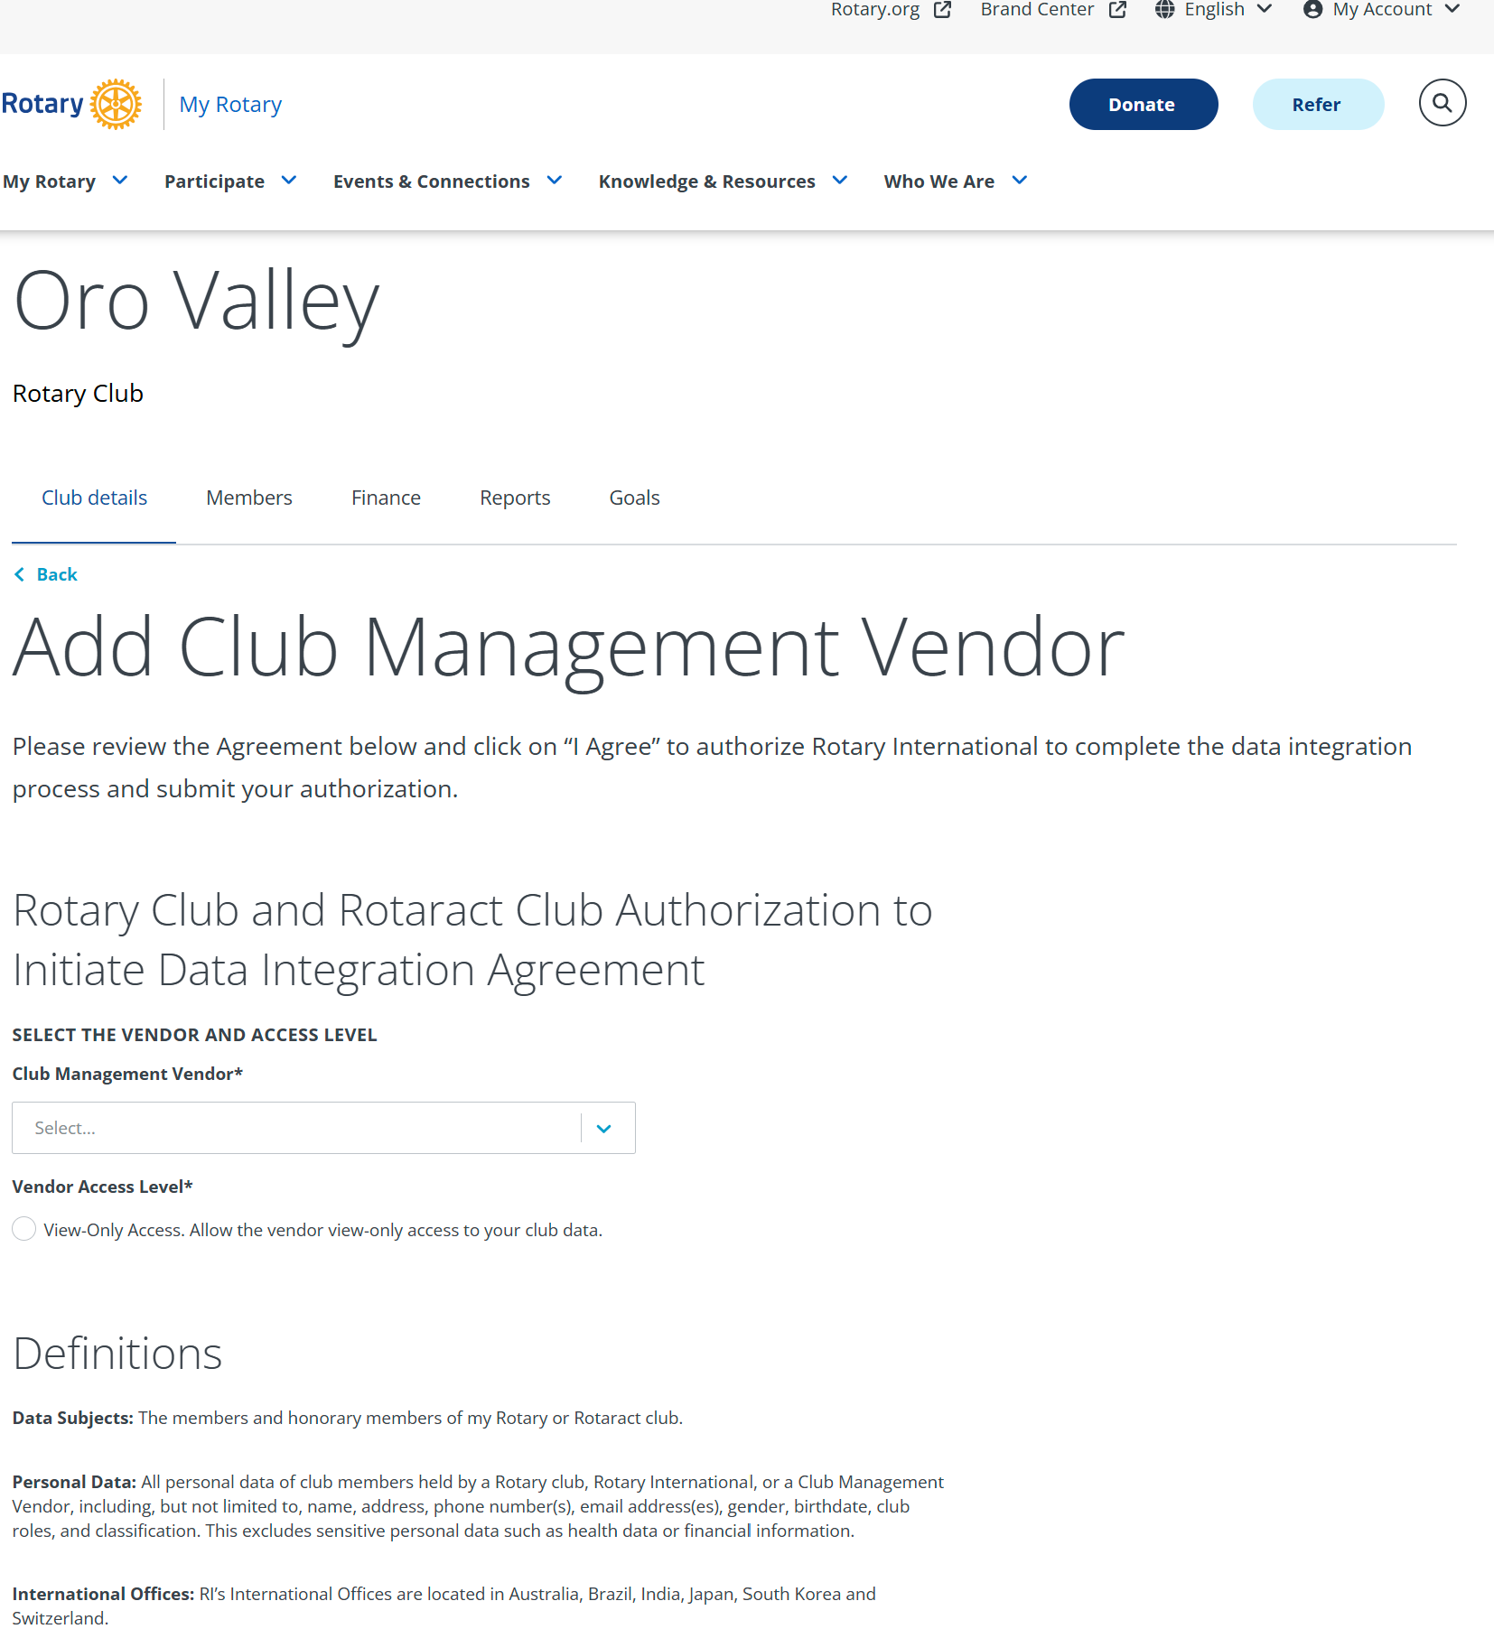
DACdb-RI Connection on
MyRotary.org
Select “DACdb” from list

Slide 7
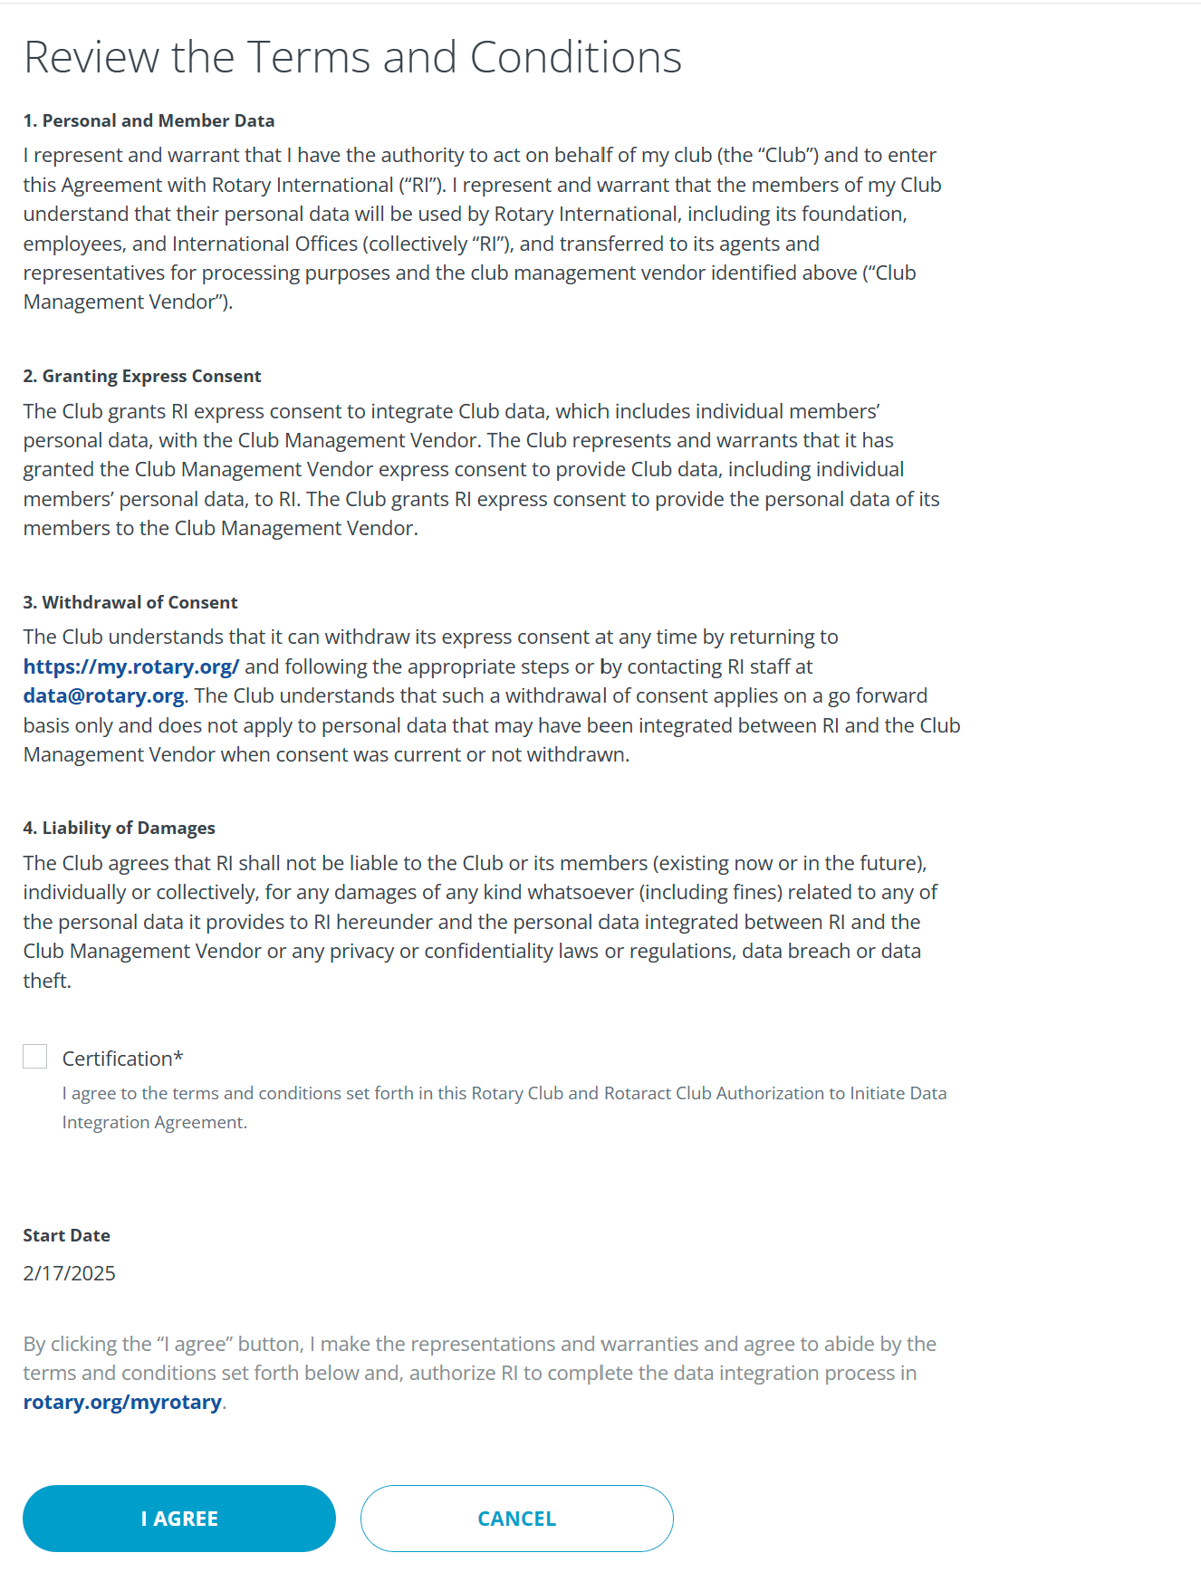
DACdb-RI Connection on
MyRotary.org
Click to certify
Click to agree

Slide 8
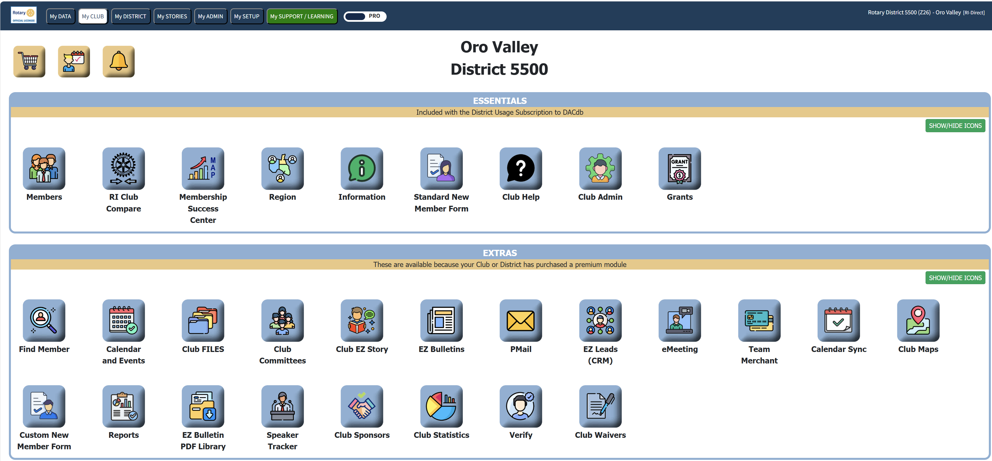
DACdb-RI Connection
on DACDdb
Select “Club Admin”
NOTE- your icon layout may be slightly different

Slide 9
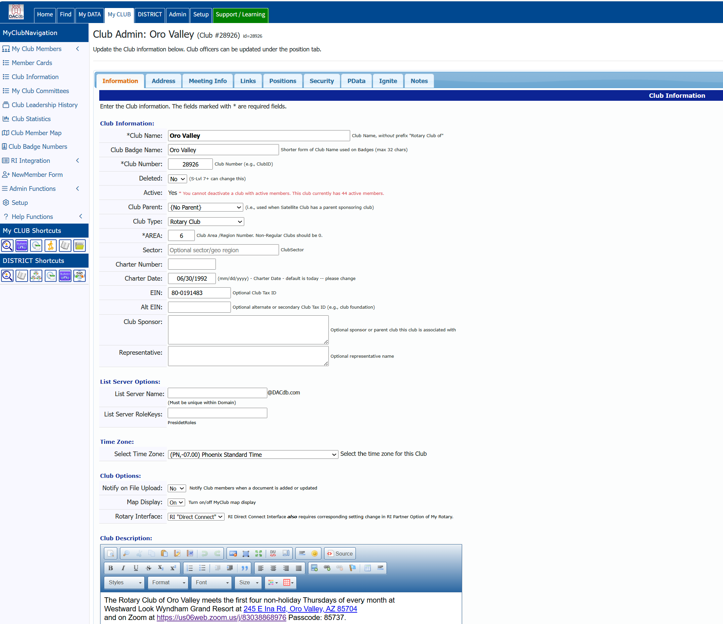
DACdb-RI Connection
on DACDdb
Select RI “Direct Connect”

Slide 10
DACdb (“District and Clubs Data Base”)
The D5500 Membership Management System Switch Your Club to DACdb Direct Connect
Leo Lawrenson, Leo@Lawrenson.com

